Slide 1
Valve Options
Jennifer Yang
June 28, 2021

Slide 2
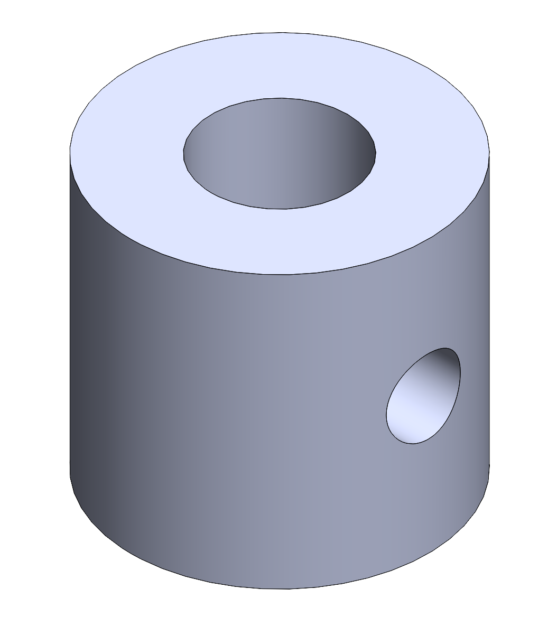
Inserts
Test IDs of 1/2, 3/8, 1/4, 1/8, 1/10 inches
Held in with an 8-32 set-screw
$0.45
Notes:
How should I get the cad to you?
Can I have the set screw hole in there or should I just expect to drill it out later
Do we have access to taps? Specifically do we have access to an 8-32 tap?

Slide 3
Needle Valve
Cheap
Would require either 4 or 8
All options were unclear if they were one or two way
Looked for ½” NPT valves only
Notes:
The ones I looked at did not specify

Slide 4
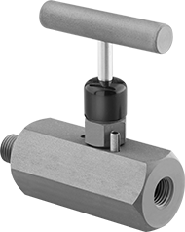
Needle Valves
McMaster
$51.41 each
1/2” NPT male and female
Steel
Maximum pressure: 6000 psi at 200°F

Slide 5
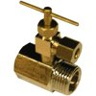
Needle Valves
Walmart
$16.22 each
1/2” NPT Male and Female
Additional 1/4” NPT Female
Brass
No technical specs

Slide 6
Proportional Solenoid Valves
Expensive
Would require 4 or 8
One option was unclear if it was one or two way
Looked for ½” NPT valves only

Slide 7
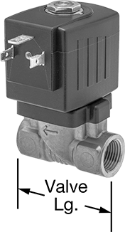
Proportional Solenoid Valves
McMaster
$280.04 each
1/2” NPT female
Brass
Maximum pressure: 145 psi at 190° F
Unsure if one or two way

Slide 8
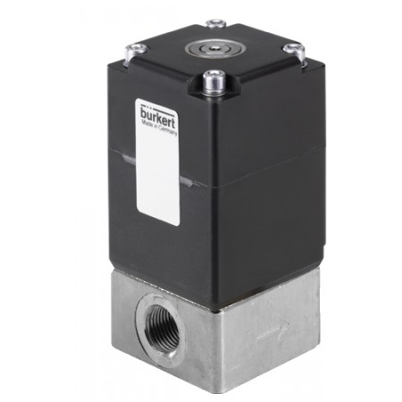
Proportional Solenoid Valve
Tameson
$312.30 each
1/2” NPT female
Stainless Steel
Pressure Range: 0-25 bar
Two way

Slide 9
Recommendations
Test with inserts first
Open to more possible sizes
If that fails, try the McMaster needle valve
More expensive option but we know more about it
Would not recommend the proportional solenoid valves
Not worth the money right now

